Slide 1
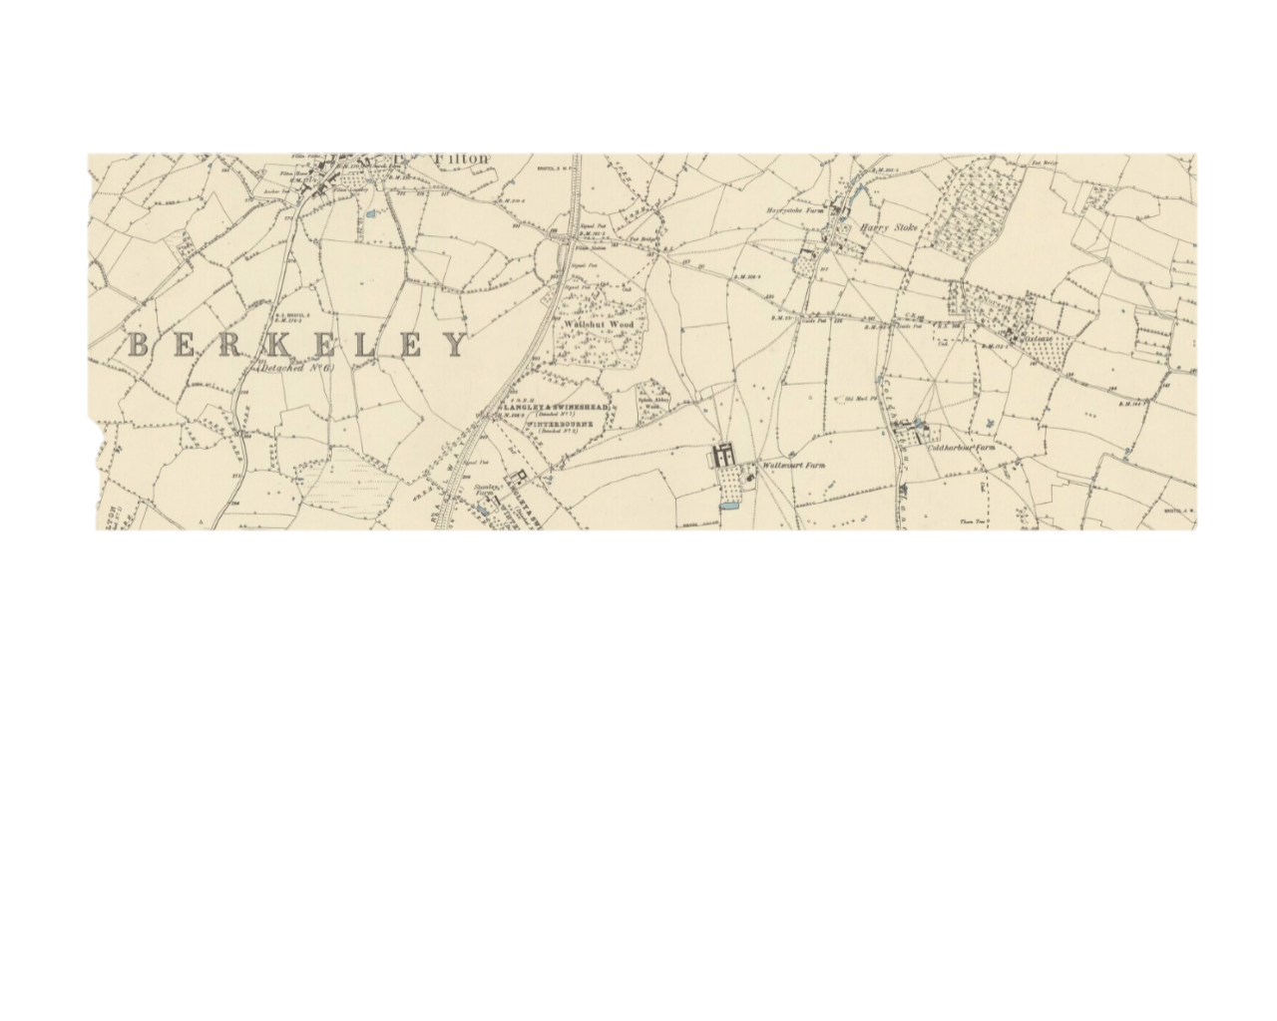
Map of Stoke Gifford 1850’s

Slide 2
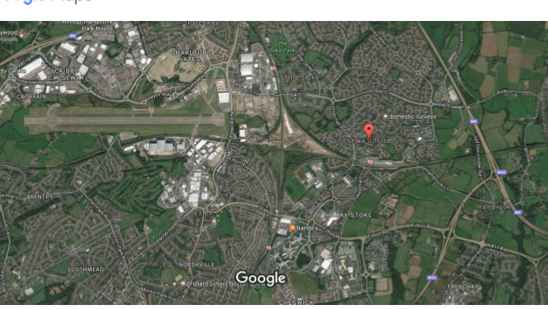
Modern Day Stoke Gifford

Slide 3
Group A Map Activity
Compare 2 maps of the same place e.g. Stoke Gifford 1850’s and modern day
One map is an old one e.g. 19th Century and the other one is modern day (you could find this on Google Maps)
Discuss any differences you notice – how has the area changed? e.g. does one have more countryside than the other? Are there buildings on one map not on the other?
Have any place names changed?
Record your answers on the activity sheet provided.
Now use the internet to research old maps and compare them to a view from Google Earth or a modern map. What changes have taken place?

Slide 4
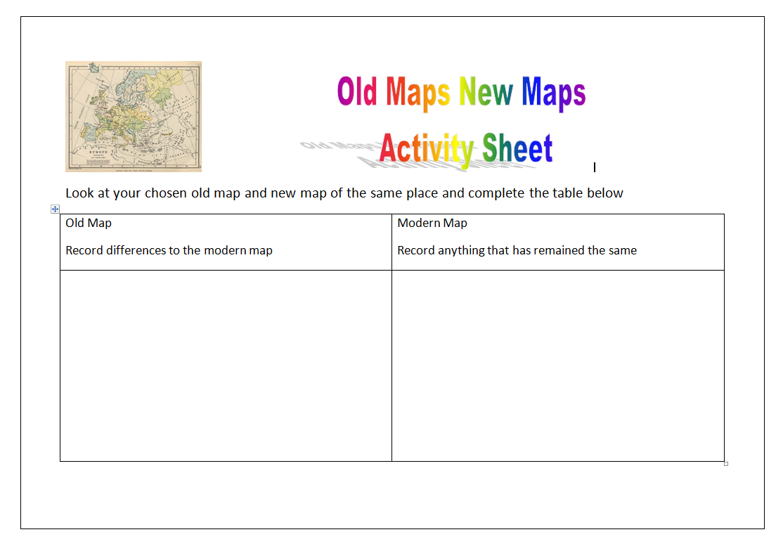

Slide 5
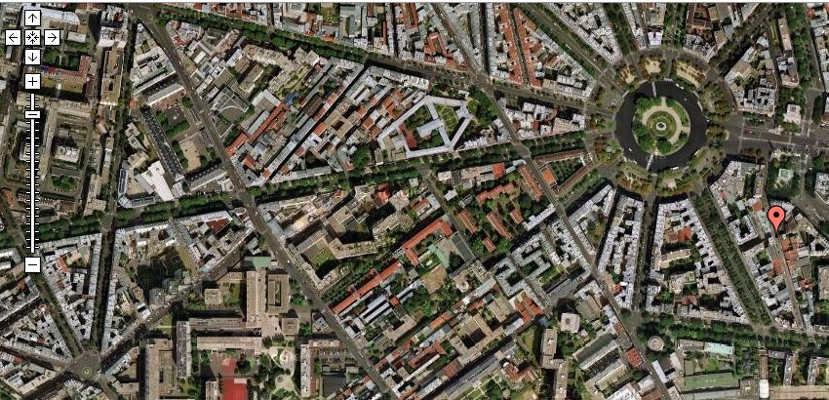
Google Journeys
In your group, take turns to go on a google journey using the internet.
In your geography note books, write down the place names and a description of the physical features of your chosen destinations.

